Slide 1
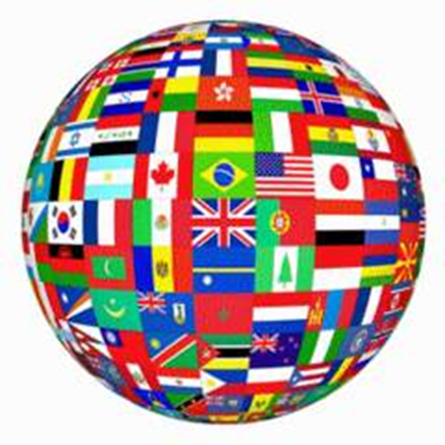
Cross Cultural Communication
Week 2, Fall 2017
Gloria Walker, ABC, FRSA

Slide 2
Course Objectives
Facilitate understanding of the competencies required to overcome barriers to cross-cultural communication
Develop in students the capacity to communicate appropriately and effectively in diverse cultural contexts.
Topics and discussion areas include . . .
Cultural awareness and cultural identity
Communication and communication competence
Managing conflict across cultures
Cross-cultural communication in the workplace
Cross-cultural communication in business situations

Slide 3
Course Requirements
“My Culture” photo essay 20%
Book or film review 20%
Cross-cultural business practices report 30%
(working in pairs)
Final exam 20%
Participation 10%
Total 100%

Slide 4
Course Schedule
Week 1 – Sept 11, 13
Culture, communication and business
Reading: Quappe and Cantatore
Week 2 – Sept 18, 20
Personality, cultural identity, cultural representations
Reading: Hooker
Week 3 – Sept 25, 27
Cultural theories – Hall and Hofstede; national cultures and cultural clusters
Reading: Hall’s Iceberg Model
Week 4 – Oct 2, 4
Cultural theories – Trompenaars and Hampden-Turner, Meyer
A1 “My Culture” photo essay due

Slide 5
Week 5 – Oct 9, 11
Cultural representations; cross cultural differences in communication styles
Reading: Acosta
Week 6 – Oct 16, 18
Communicating interculturally; improving intercultural communication skills
Reading: Liu et al
Week 7 – Oct 23, 25
Communication and cultural competence; ethnocentrism and ethnorelativism
Readings: Wang; Bennett
Week 8 – Oct 30, Nov 1
Other cultural influences – gender, religion, age, and other issues
Culture and business – negotiation, conflict and feedback
Reading: Cuddy et al
A2 book or film review due

Slide 6
Week 9 – Nov 6, 8
Organizational culture, models and actual organizations
Reading: Hofstede
Week 10 – Nov 13, 15
Business practices; cultural and international marketing
Reading: Passport to Trade 2.0; Dahlvig; Tian & Boyes
Week 11 – Nov 20, 22
Reading Week – no classes
Readings: Harvard Business Review; Lau
Week 12 – Nov 27, 29
Group dynamics; individual and group identities
Effective teams; team diversity
A3 reports due

Slide 7
Week 13 – Dec 4, 6
Stakeholders and cultural intermediaries
Leadership and culture
Week 14 – Dec, 11, 13
Reputation and cultural issues
Cultural intelligence and intercultural effectiveness
Wrap-up and exam review
A5 Participation completed
Week 15 – Dec 18 – 21 (specific date to be confirmed)
A4 Final examination

Slide 8
“My culture” Photo Essay
Drawing on your own personal experiences and reflecting on cultural models (weeks 3 and 4), you should compile a personal cultural profile (1000 – 1500 words), reflecting on cultural traits you share with your culture of origin and other traits that set you apart. The essay will include photographs (minimum of 10) to illustrate key aspects and themes, such as family, hobbies, representations in London, landmarks, etc. A photo essay is very simply a collection of images that are placed in a specific order to tell the progression of events, emotions, and concepts.
The photo essay takes the same story telling techniques as a normal essay, translated into visual images.

Slide 9
Tips for a good photo essay
Find a topic (your cultural autobiography)
Do your research (investigate, talk to people)
Find the real story (what’s your angle?)
Every dynamic story is built on a set of core values and emotions that touch the audience (find and use emotions)
Plan your shots (each shot works like a sentence and emphasizes part of the narrative)
All you need is a bit of photographic technique, some creativity and a lot of heart. Find the story and tell it in pictures.

Slide 10
Cross Cultural Communication
Ethnocentrism Profile
62 students

Slide 13
Cultural Awareness

Slide 14
Different kinds of culture
Culture is generally divided into two different types: material culture and non-material culture.
Material culture is similar to class status. An example of material culture is buying expensive cars, jewellery and clothing to reflect an elite status within a community.
Non-material culture is derived from intangible things such as beliefs, traditions and values.

Slide 15
In addition to material and non-material culture, there are less dominant kinds of culture called subculture and counterculture.
Subculture refers to a group of people who hold opposing beliefs or behave differently than the majority of people in their community. Members of a subculture also often create a language that is distinct from the majority. Consequently, this smaller community establishes a culture that may ostracize them from the rest of society.

Slide 16
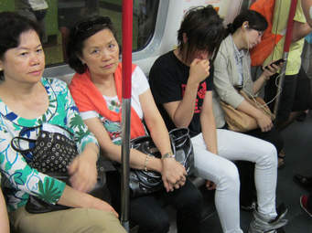
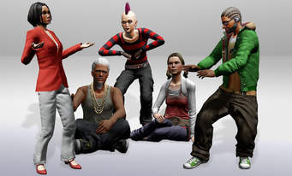

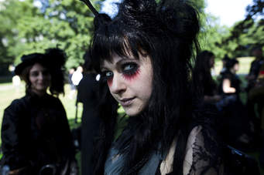

Slide 17
Counterculture is a movement to actively defy one or more aspects of dominant culture. Examples of counterculture groups include the Ku Klux Klan, members of the hippie movement and militant groups that protest government control.

Slide 18
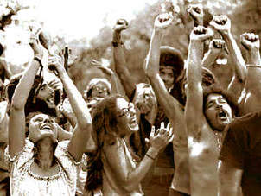
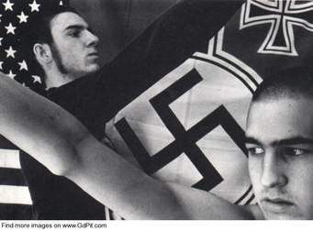

Slide 19
Ultimately, culture is defined as the way of life for a community of people. In this sense, any one person has several different kinds of culture that apply to him or her. For example, a person's religious beliefs, race, behaviour, occupation and interaction within the community are all forms of culture.

Slide 20
Cultural differences
Affect business and communication
Customs
Language barriers
Target audiences
Technology
Politics

Slide 21
Meaning is a problem
People differ in many ways.
What are some of the ways we differ in this room?

Slide 22
personality

Slide 23
What is Personality?
We often hear “that’s just the kind of person he/she is.”
It’s a mainstay of both common and academic thinking that there are “types of people.”
Psychology defines personality as “an individual’s characteristic style of behaving, thinking, and feeling.” – Schater et al (2009).
Results of your self-assessment.

Slide 24
“Big Five” Dimensions http://www.truity.com/test/big-five-personality-test
Extraversion vs Introversion
Agreeableness vs Antagonism
Conscientiousness vs Lack of Direction
Neuroticism vs Emotional Stability
Openness vs Closedness to Experience

Slide 25
Cultural Identity

Slide 26
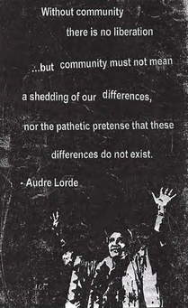
Poet, essayist, and novelist

Slide 27
Cultural Identity
We call “what we are” our identity.
There are lots of ways for it to differ.
These differences affect the encoding and decoding of messages.

Slide 28
How can we analyse Identity?
We need to think about identity so we can think about the ways it affects communication.
What do you think? How can we do it?
Exercise – Identity Exploration

Slide 29
How do identities differ?
One of the ways identities differ is in “origin” or “nationality.”
That’s part of why intercultural communication is a particular challenge for business.
We’ve identified IDENTITY as a key issue in communication.
There are three ways to think about what identity is composed of.

Slide 30
Three Lenses
Personality
Goals / Motivations / Incentives
Social

Slide 31
Goals, Motivations and Incentives
This category represents some of the things that lie between personality explanations and social explanations.
Crucially, both personality traits and cultural traits are assumed to be long-lasting.

Slide 32
Things that change
Goals – what is each side trying to achieve ?
Motivations/Morals – Is there an intent to deceive? Or cheat in some other way?
Incentives – what are the possible rewards or punishments affecting the communicator at this time?

Slide 33
The Social Lens
You’ll see a lot of references to culture, in the syllabus and in the course materials.
Culture is how we talk about social limits & imperatives to behaviour.
Key: the realisation that some things largely hold true according to culture, even across different personalities and with different G/M/I.

Slide 34
Manifestations of Cultural Differences (Hofstede 1990)
Symbols
Heroes
Rituals
Values
Practices
Notes:
34

Slide 35
A Contextual Model of Intercultural Communication Neuliep 2009
Mi
Environmental context
Environmental Context
N
Perceptual context of person from culture A
Socio-relational Context
Verbal code
Perceptual context of person from culture B
Non-verbal code
Micro-cultural context
Cultural Context
Notes:
35

Slide 36
Cultural identity exercise

Slide 37
LANGUAGE
A major cultural factor
Does speaking a language enable you to understand the culture?

Slide 38
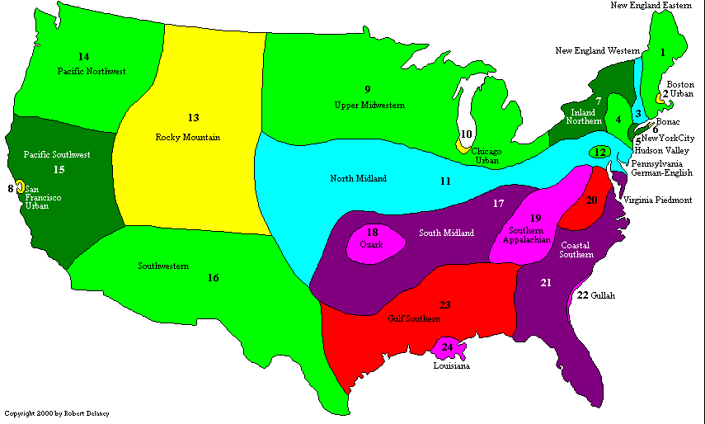

Slide 39
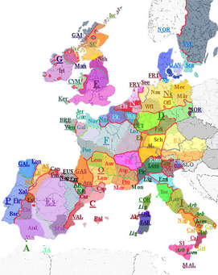

Slide 40
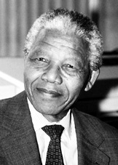
If you speak to a man in a language he understands, you speak to his head.
If you speak to a man in his own language, you speak to his heart. Nelson Mandela

Slide 41
PROBLEM OF LANGUAGE
There are more than 3000 languages in use on earth.
More than 200 languages are used in India itself.

Slide 42
Wide differences among languages make precisely equivalent translation difficult because languages are generally based on experiences, different concepts, views and such of the culture that developed them.
And different cultures have different concepts, views, experiences, etc.

Slide 43
For example -
Florist in America means someone who sells flowers while in some cultures the word florist is irrelevant because flowers are sold by street vendors mainly women and children.
Similarly supermarket has no equivalent in some languages.
The French language has no word distinguishing house and home, mind and brain, and man and gentleman.

Slide 44
Like-meaning words can be used in different ways in different cultures. Example – yes
The Chinese yes, like the Japanese yes, can often be understood by Americans and British as their English yes. But the Chinese yes often means ‘I am listening’. For example, when an American says to Chinese counterpart , ”I see you don’t agree with this statement,” the Chinese will usually reply, “Yes” meaning a polite agreement with the negative question: ‘ Yes you are right. I do not agree with the statement’.

Slide 45
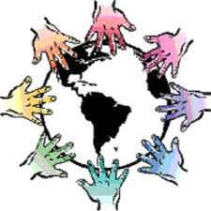
LACK OF LANGUAGE EQUIVALENCY

Slide 46
For Week 3
Culture theories
Cultural dimensions

